Slide 1


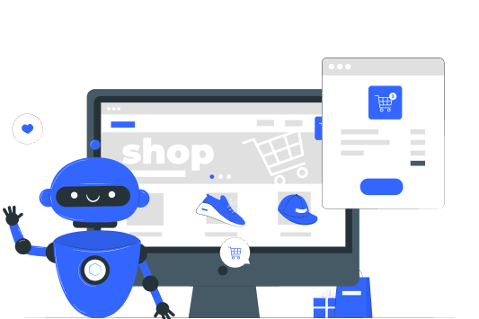
Title:
Price Negotiating Chatbot with Text &Voice on E- commerce website
By..
Pitchala Sekhar - 21221A6146
Kollu Satish - 21221A6136
Satyavarapu Praveen - 21221A6150
Tatikayala Pavan Kumar - 21221A6153
Under the Esteemed Guidance of Mr.SESHA GIRI RAO THALLURI -Associate Professor-(AIML)

Slide 2
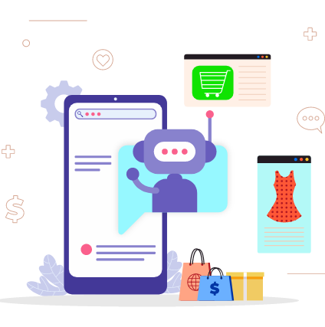
List of Contents:
Abstract
Introduction
Existing System
Disadvantages of Existing System
Proposed System
Advantages of Proposed System
System Requirements
Modules
Use Case diagram
Sample screens
Conclusion

Slide 3
Abstract:
Artificial intelligence (AI) has been used to develop and advance numerous fields and industries, including finance, healthcare, education, transportation and more. However, in the business negotiation field, such as bargain, the AI has not yet exerted its power. In order to explore the application of AI into business negotiation, we have built an intelligent robot that can help customers that lack negotiation skills when bargaining in their shopping sceneries. This bot can make decision by itself via price prediction function implemented by machine learning algorithms and the tool of decision tree. As a result, our bot has got a positive performance during a used car trade. Although the algorithm of the project is relatively simple, its main contribution is to show the potential application of AI in the business negotiation. We believe that it can provide ideas and directions for the future development of business negotiation robot

Slide 4
Introduction:
E-commerce websites today apply various AI techniques to determine most liked products or most sold products which eventually are calculated to provide an effortless search for customers shopping on their website. But at times when the best products are sold at high prices, customers have to compromise on their product. There are also some other problems that customers may face on low-cost products. These problems can be eliminated by giving them an opportunity to negotiate on the products. Negotiation is a combination of both linguistic and reasoning problems. Negotiation is the process of exchanging the highest likelihood of satisfying the needs of both parties [3]. The first party i.e. product seller will provide a minimum price along with the product data that he/she can afford to sell the product at. This price and the product price before negotiation (original price) are the limits for our algorithm

Slide 5
Existing Model
Consumer behavior means studying how people choose, buy, use, or throw away products and services to meet their needs and wants. Many companies try to understand this behavior to improve customer satisfaction and increase profits. In 2017, Facebook's AI research team (FAIR), along with Georgia Tech, trained bots using over 5000 negotiation examples. At first, the bots were too easy to compromise when trained like humans. Later, when trained using belief analysis, the bots often gave false replies. One popular algorithm used for this task is SVM (Support Vector Machine), which handles complex data and helps make better predictions.

Slide 6

Disadvantages of Existing System:
Low accuracy in predicting the right price.
Less efficiency in handling real-time user interactions.
No option for customers to negotiate prices.
Fails to adapt to new trends or missing data.
Fixed pricing causes users to leave without buying.

Slide 7
Proposed System:
The dataset of e-commerce items containing the price of products and their minimum prices i.e min price which will be used for negotiating. The website for demonstrating the working is made upon HTML, CSS, JavaScript for front end while the backend uses Flask. Database is made by MariaDB. In an E-commerce website the customers select the product(s) that they wish to buy, then they proceed with ordering the product(s). On our website we have added the chatbot where they purchase the product by placing a button to negotiate. The offer price will be then stored when they are satisfied. They can select whether they want to buy that product or add the product to cart and see for another product(s). Customers judge the products on E-commerce websites by various factors such as ratings, price, reviews, etc. But for some customers, price plays a crucial role in the decision for purchasing a product

Slide 8
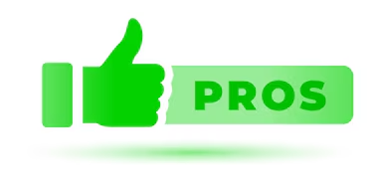
Advantages of Proposed System
Offers dynamic pricing through real-time negotiation.
Increases customer satisfaction by making products more affordable.
Integrates both text and voice interfaces for accessibility.
Achieves higher accuracy and efficiency by combining multiple AI models.
Uses sentiment analysis for better understanding of customer feedback

Slide 9




System Requirements
Software Requirements
Python
VS Code
Flask
Operating Systems supported
Windows
Hardware Requirements:
System : i3 or above.
Ram : 4 GB.
Hard Disk : 40 GB

Slide 10
Modules
User Registration and Login
Product Browsing
Chatbot for Price Negotiation (Text and Voice)
Price Prediction using Machine Learning
Sentiment Analysis of Customer Reviews
Order Placement and Transaction
Review Posting and Feedback Collection
Admin Monitoring and Data Management
.

Slide 11
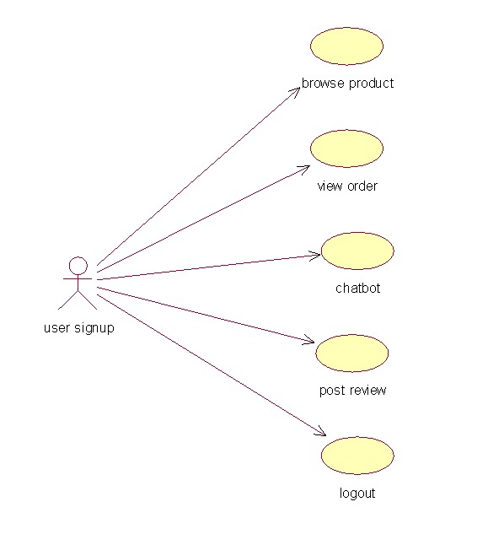
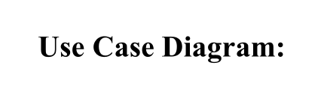

Slide 12
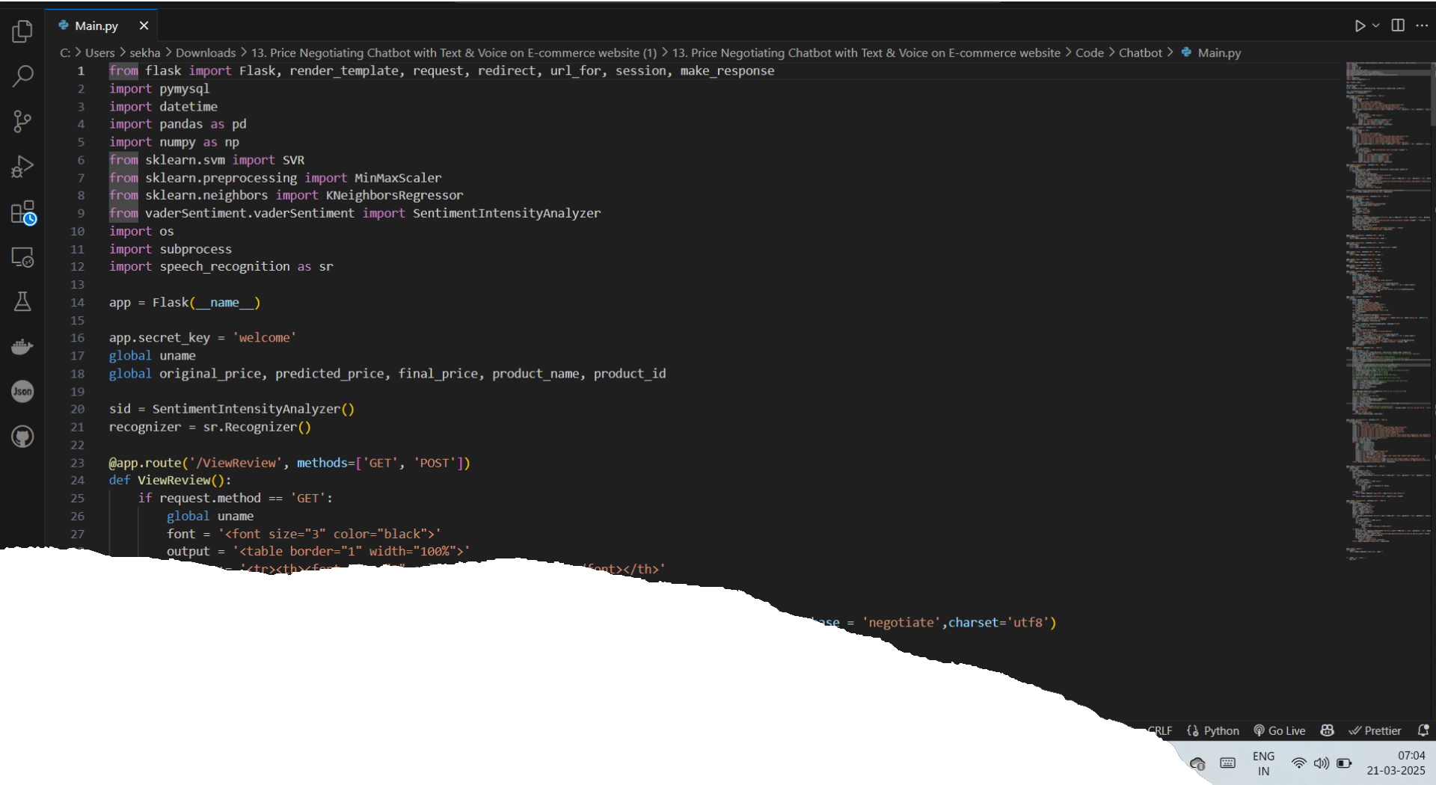
Code Implementation

Slide 13

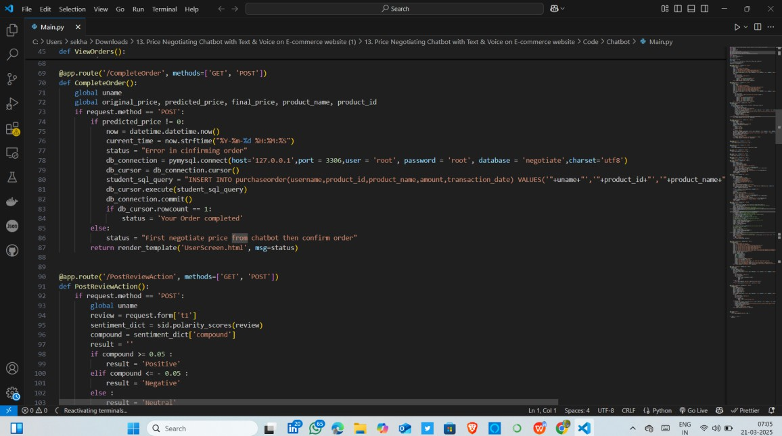
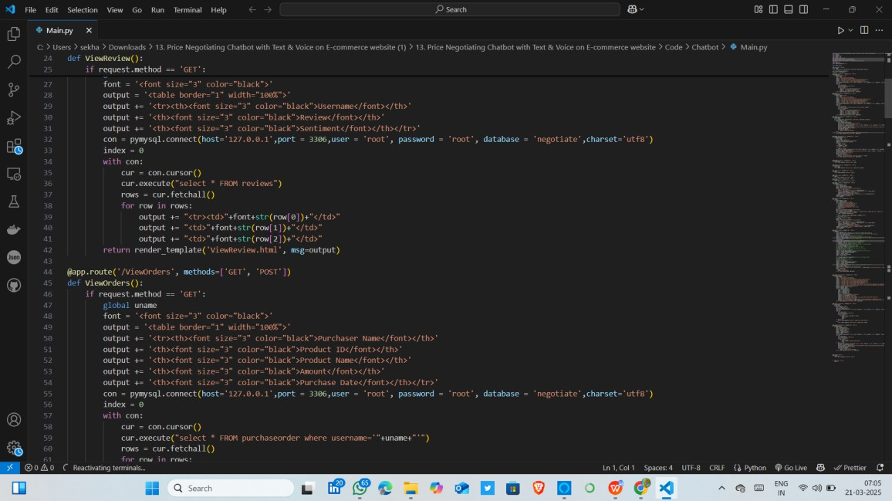

Slide 14
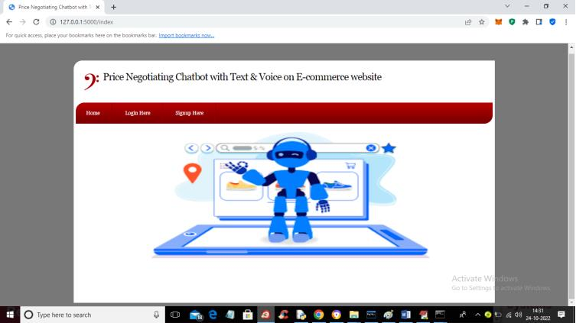
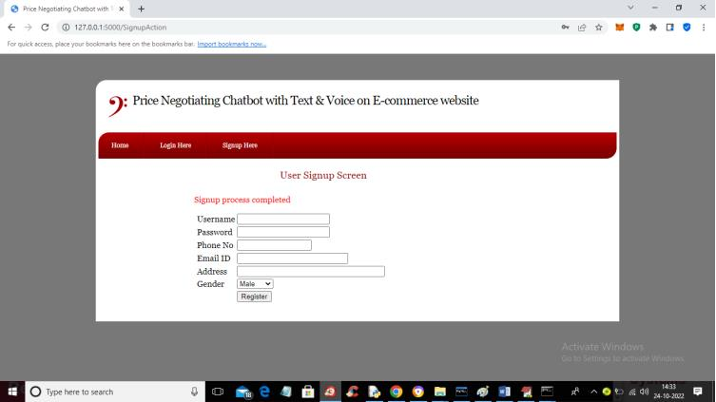
Sample Screenshots:
In above screen click on ‘New Registration Button’
Interface

Slide 15
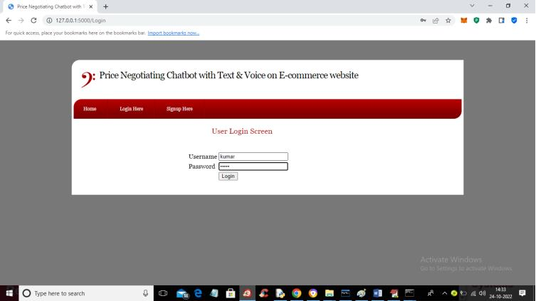
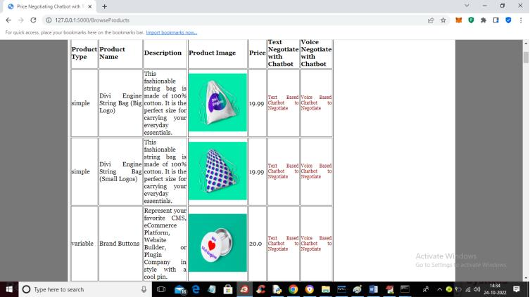
In above screen open the product list or product browsing page.
In above screen click on ‘Login Button’

Slide 16
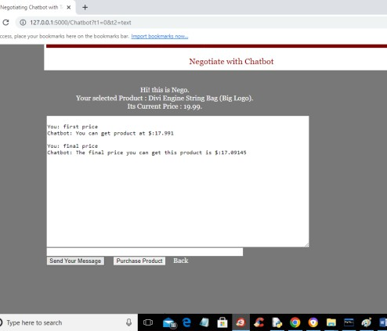
Now click on Text Negotiate button.
Click on the "Send Message" button next to the product you want to negotiate.

Slide 17
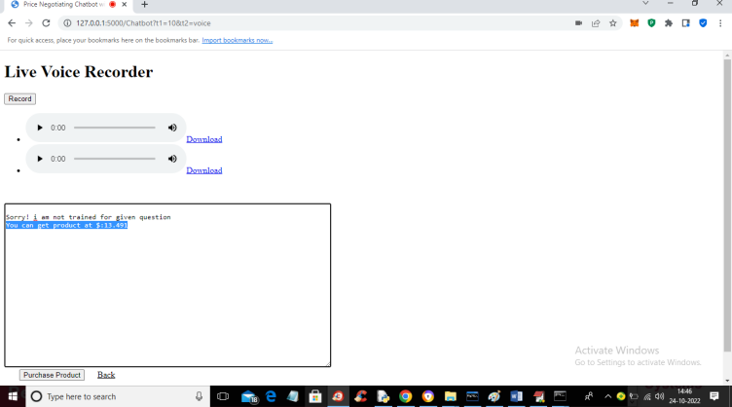
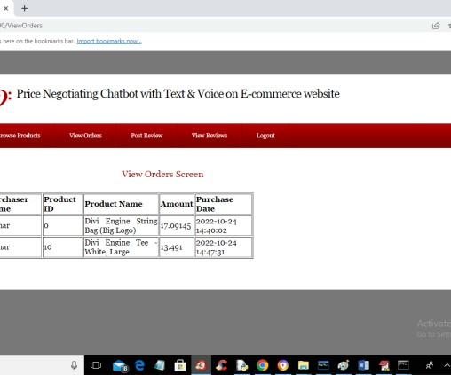
Click on the ‘View Orders’ button in the top menu to see the list of products you have purchased along with their details like product name, amount, and purchase date
Click on the ‘Voice Negotiate’ button to speak with the chatbot using voice commands

Slide 18
Conclusion:
The negotiation on products is a challenging task when it comes to e-commerce systems. We tried a primary chatbot that covers many aspects and cases for negotiation but is not evident to provide the best results. The chatbot which we created sometimes falls to the price customers ask for though it is always greater than minimum price but may result in loss for seller if it goes the same for many customers. Such situations have to be handled. We used various algorithms such as SVM, KNN but in future there may be some better price prediction algorithms which can be used the ways in which a user can better negotiate with chatbot and get cheaper prices. Such cases should be handled. KBAgent is considered to be better when it comes to negotiation, this can be added to our application. An example can be Apple’s Siri which has huge knowledge base to provide satisfactory outcomes.

Slide 19
